Slide 1
Boolean Algebra
and
Logic Simplification
Chapter 4
Week 1
Sumaiyah Zahid

Slide 2
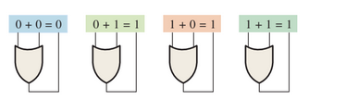
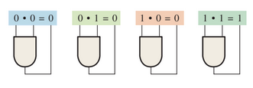
Boolean Algebra
Boolean algebra is the mathematics of digital logic.
Determine the values of A, B, and C that make the sum term A` + B` + C equal to 0.
Determine the values of A, B, and C that make the product term AB`C equal to 1.

Slide 3
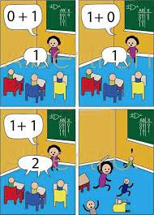
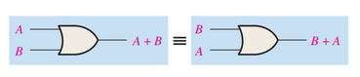
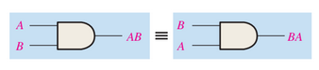
Laws of Boolean Algebra
Commutative Laws

Slide 4
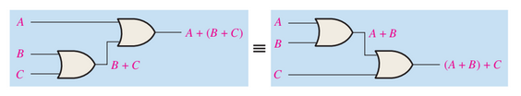
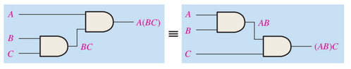
Laws of Boolean Algebra
Associative Laws

Slide 5
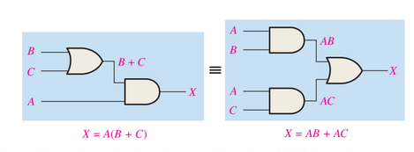
Laws of Boolean Algebra
Distributive Laws

Slide 6
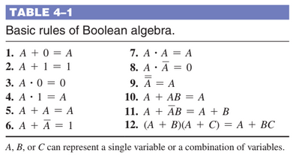
Rules of Boolean Algebra

Slide 7
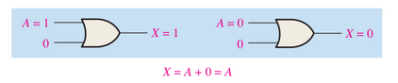
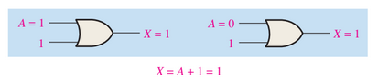
Rules of Boolean Algebra
Rule 1: A + 0 = A
Rule 2: A + 1 = 1

Slide 8
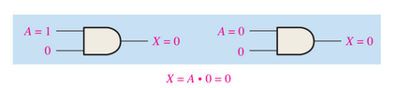
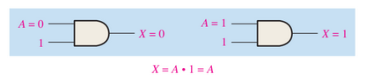
Rules of Boolean Algebra
Rule 3: A.0 = 0
Rule 4: A.1 = 1

Slide 9
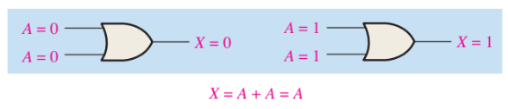
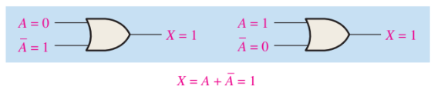
Rules of Boolean Algebra
Rule 5: A + A = A
Rule 6: A + A` = 1

Slide 10
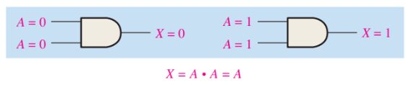
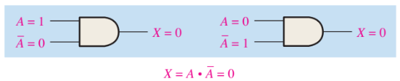
Rules of Boolean Algebra
Rule 7: A.A = A
Rule 8: A.A` = 0

Slide 11
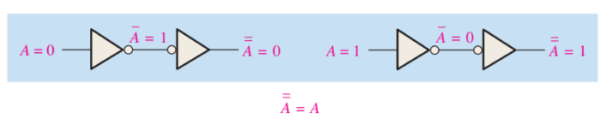
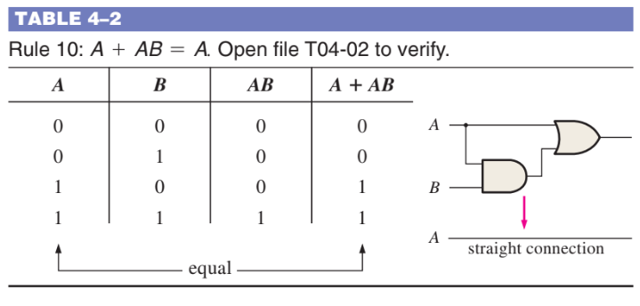
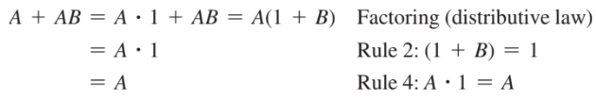
Rules of Boolean Algebra
Rule 9: = A
Rule 10: A + AB = A

Slide 12
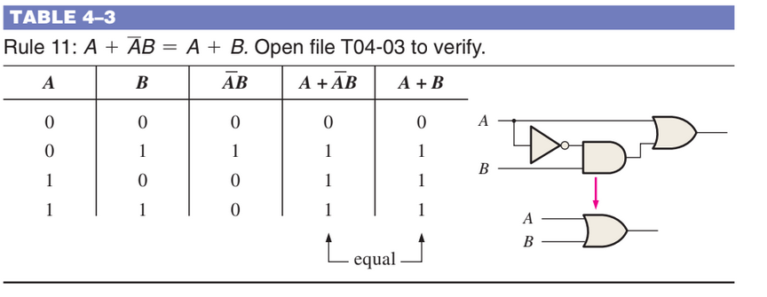
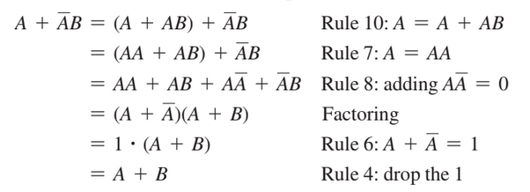
Rules of Boolean Algebra
Rule 11: A+A`B = A + B

Slide 13
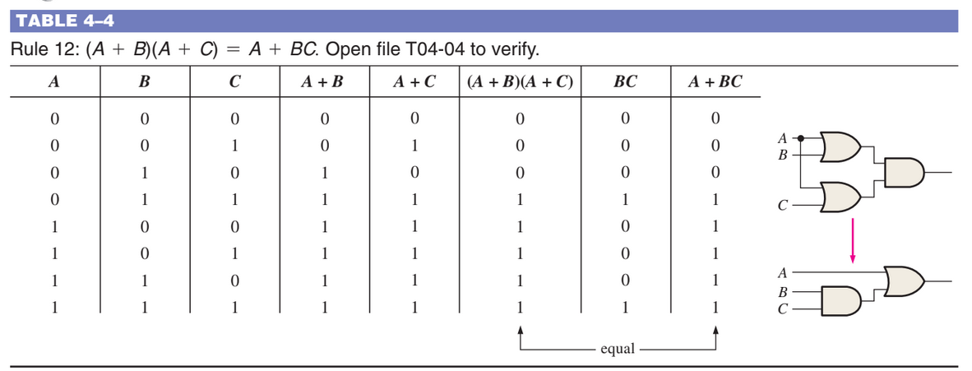
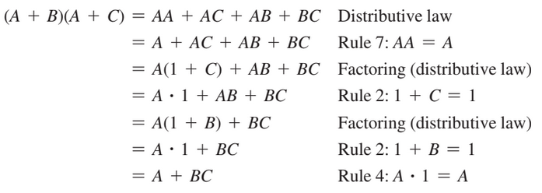
Rules of Boolean Algebra
Rule 12:(A+B)(A+C)= A+BC

Slide 14
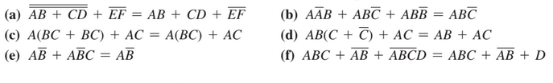
Practice Exercise

Slide 15
Practice Exercise

Slide 16
Practice Exercise
Using Boolean algebra techniques, simplify the following expressions as much as possible:
(a) A(A + B) (b) A(A’ + AB) (c) BC + B’C
(d) A(A + A’B) (e) AB’C + A’BC + A’B’C

Slide 17
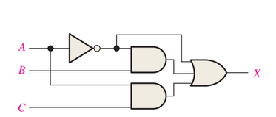
Practice Exercise
Write the output expression for circuit and simplify it if possible.

Slide 18
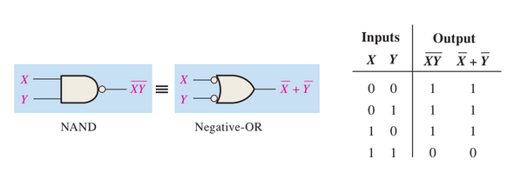
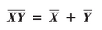
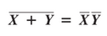
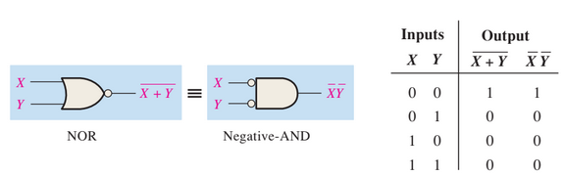
De Morgan’s Theorem
The complement of a product of variables is equal to the sum of the complements of the variables.
The complement of a sum of variables is equal to the product of the complements of the variables.

Slide 19
Practice Exercise

Slide 20
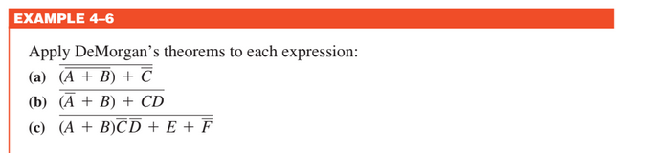
Practice Exercise

Slide 21
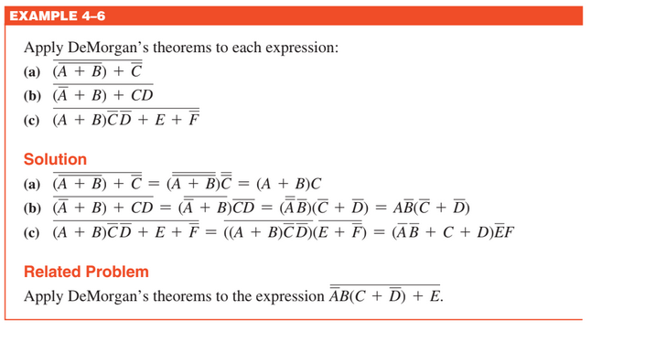
Practice Exercise

Slide 22
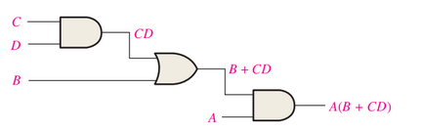
Boolean Analysis of Logic Circuits,
Boolean Expression for a Logic Circuit

Slide 23
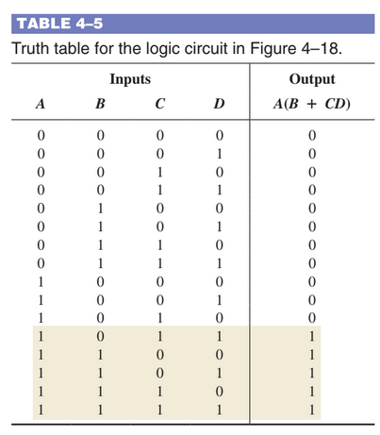
Boolean Analysis of Logic Circuits,
Constructing a Truth Table for a Logic Circuit

Slide 24
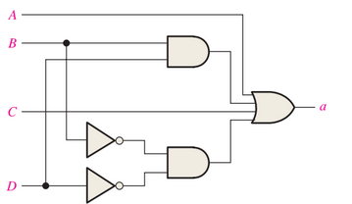
Practice Exercise
Write a Boolean expression for the logic circuit and construct the truth table.

Slide 25
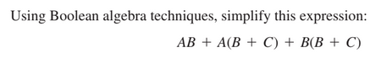
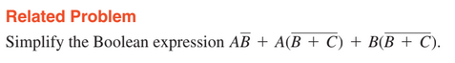
Logic Simplification Using Boolean Algebra,

Slide 26
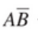
Logic Simplification Using Boolean Algebra,
==
==

Slide 27
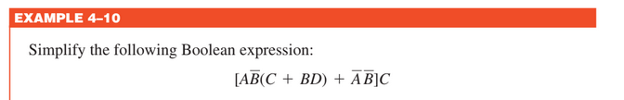
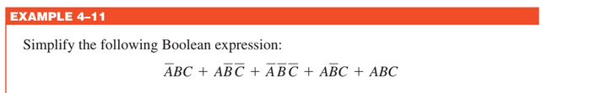
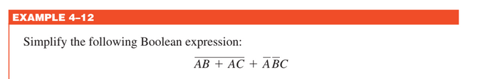
Logic Simplification Using Boolean Algebra,

Slide 28
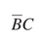
Logic Simplification Using Boolean Algebra,

Slide 29
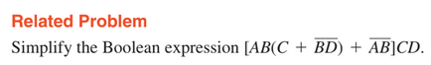
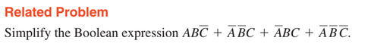
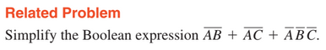
Logic Simplification Using Boolean Algebra,

Slide 30
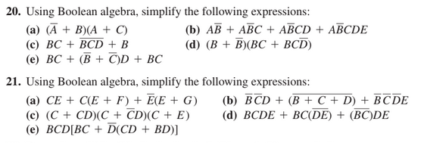
Practice Exercises

Slide 31
Standard Forms of Boolean Expressions
All Boolean expressions, regardless of their form, can be converted into either of two standard forms:
The sum-of-products form
The product-of-sums form

Slide 32
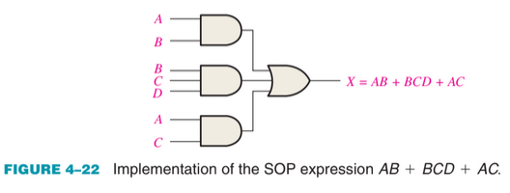
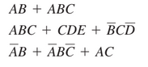
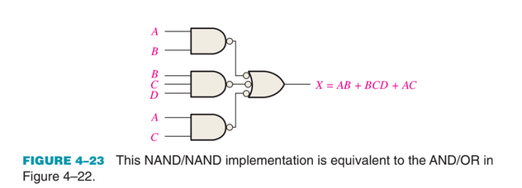
The sum-of-products form

Slide 33
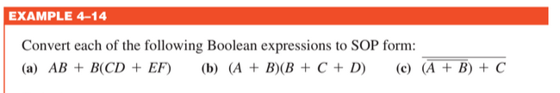
The sum-of-products form

Slide 34

The sum-of-products form

Slide 35

Standard SOP form
A standard SOP expression is one in which all the variables in the domain appear in each product term in the expression.

Slide 36

Standard SOP form

Slide 37

Binary Representation of Standard Product Term
Construct the Truth table for given SOP expression.

Slide 38

Binary Representation of Standard Product Term
Construct the Truth table for given SOP expression.

Slide 39

Practice Exercises

Slide 40



The Product-of-Sums form

Slide 41

Standard POS form
Rule 8: A.A` = 0
Rule 12:(A+B)(A+C)= A+BC

Slide 42
Standard POS form

Slide 43

Binary Representation of Standard Sum Term
Construct the Truth table for given POS expression.

Slide 44

Converting Standard SOP to Standard POS

Slide 45

Converting Standard SOP to Standard POS

Slide 46

SOP and POS from a Truth Table
From the truth table in Table determine the standard SOP and POS expression.

Slide 47
SOP and POS from a Truth Table
From the truth table in Table determine the standard SOP and POS expression.
Minterm = (3,4,6,7)
Maxterm = (0,1,2,5)

Slide 48



The Karnaugh Map
K Map is an array of cells.

Slide 49

Adjacent Cells in K Map

Slide 50

K-Map SOP Minimization

Slide 51

K-Map SOP Minimization

Slide 52

K-Map SOP Minimization

Slide 53

K-Map SOP Minimization

Slide 54

K-Map SOP Minimization

Slide 55



Numerical Expansion

Slide 56

Numerical Expansion

Slide 57

Numerical Expansion

Slide 58

Minterm Solution of K Map
Grouping the 1s

Slide 59

Minterm Solution of K Map

Slide 60

Minterm Solution of K Map

Slide 61

Minterm Solution of K Map
Determining the Equation

Slide 62
Minterm Solution of K Map

Slide 63

Minterm Solution of K Map

Slide 64

Minterm Solution of K Map

Slide 65


Minterm Solution of K Map

Slide 66

Don’t Care Conditions

Slide 67

K-Map POS Minimization

Slide 68

K-Map POS Minimization

Slide 69

K-Map POS Minimization

Slide 70


K-Map POS Minimization

Slide 71

K-Map POS Minimization

Slide 72

K-Map POS Minimization

Slide 73

Converting Between SOP and POS

Slide 74

Converting Between SOP and POS

Slide 75

Converting Between SOP and POS

Slide 76

Converting Between SOP and POS

Slide 77

Practice Exercises

Slide 78

Practice Exercises

